Slide 1
Digital Transmission

Slide 2




















































4-2 ANALOG-TO-DIGITAL CONVERSION
A digital signal is superior to an analog signal because it is more robust to noise and can easily be recovered, corrected and amplified. For this reason, the tendency today is to change an analog signal to digital data. In this section we describe two techniques, pulse code modulation and delta modulation.
Topics discussed in this section:
Pulse Code Modulation (PCM)

Slide 3
PCM
PCM consists of three steps to digitize an analog signal:
Sampling
Quantization
Binary encoding
Before we sample, we have to filter the signal to limit the maximum frequency of the signal as it affects the sampling rate.
Filtering should ensure that we do not distort the signal, ie remove high frequency components that affect the signal shape.

Slide 4
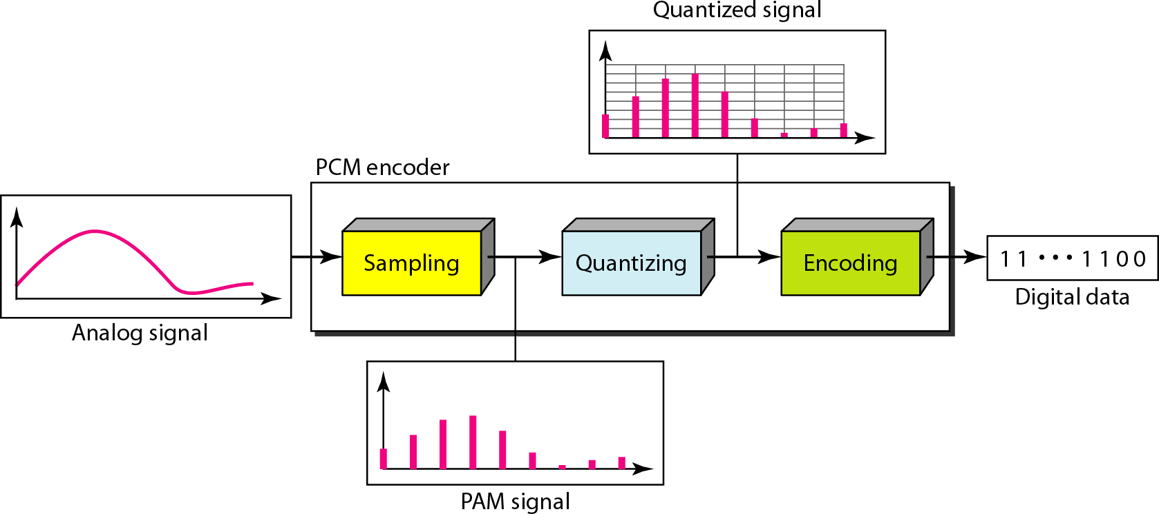
Figure 4.21 Components of PCM encoder

Slide 5
Sampling
Analog signal is sampled every T_{S} secs.
T_{s} is referred to as the sampling interval.
f_{s} = 1/T_{s} is called the sampling rate or sampling frequency.
There are 3 sampling methods:
Ideal - an impulse at each sampling instant
Natural - a pulse of short width with varying
amplitude
Flattop - sample and hold, like natural but with single amplitude value
The process is referred to as pulse amplitude modulation PAM and the outcome is a signal with analog (non integer) values

Slide 6
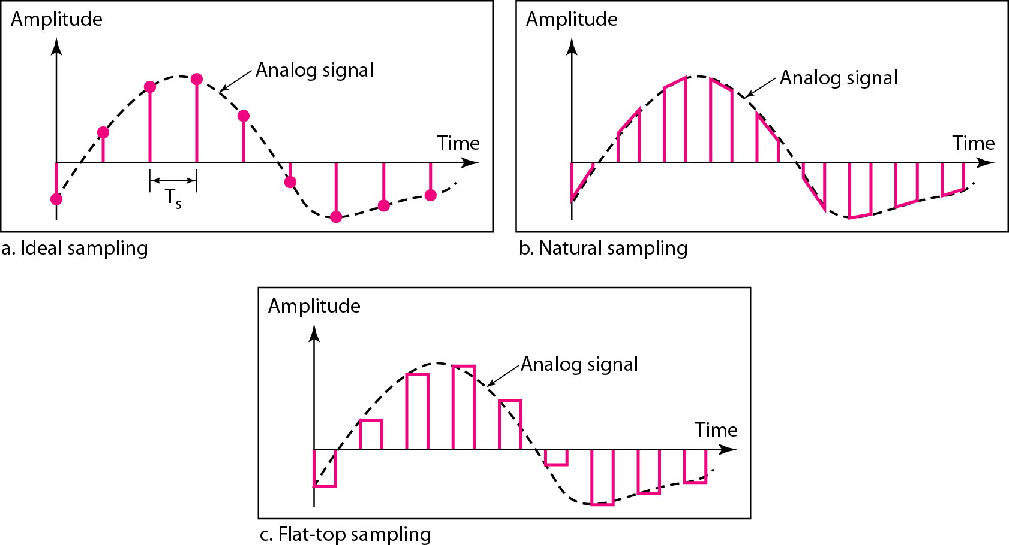
Figure 4.22 Three different sampling methods for PCM

Slide 7




Note
According to the Nyquist theorem, the sampling rate must be
at least 2 times the highest frequency contained in the signal.

Slide 8
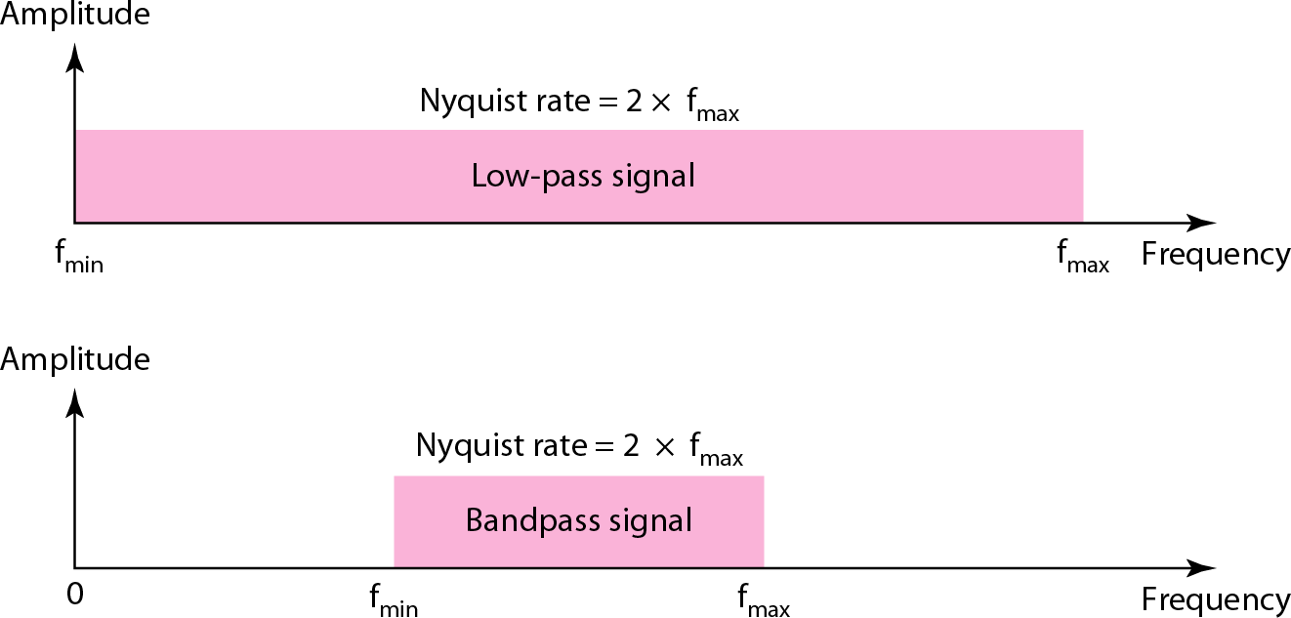
Figure 4.23 Nyquist sampling rate for low-pass and bandpass signals

Slide 9
Quantization
Sampling results in a series of pulses of varying amplitude values ranging between two limits: a min and a max.
The amplitude values are infinite between the two limits.
We need to map the infinite amplitude values onto a finite set of known values.
This is achieved by dividing the distance between min and max into L zones, each of height Δ.
Δ = (max - min)/L

Slide 10
Quantization Levels
The midpoint of each zone is assigned a value from 0 to L-1 (resulting in L values)
Each sample falling in a zone is then approximated to the value of the midpoint.

Slide 11
Quantization Zones
Assume we have a voltage signal with amplitutes V_{min}=-20V and V_{max}=+20V.
We want to use L=8 quantization levels.
Zone width Δ = (20 - -20)/8 = 5
The 8 zones are: -20 to -15, -15 to -10,
-10 to -5, -5 to 0, 0 to +5, +5 to +10,
+10 to +15, +15 to +20
The midpoints are: -17.5, -12.5, -7.5, -
2.5, 2.5, 7.5, 12.5, 17.5

Slide 12
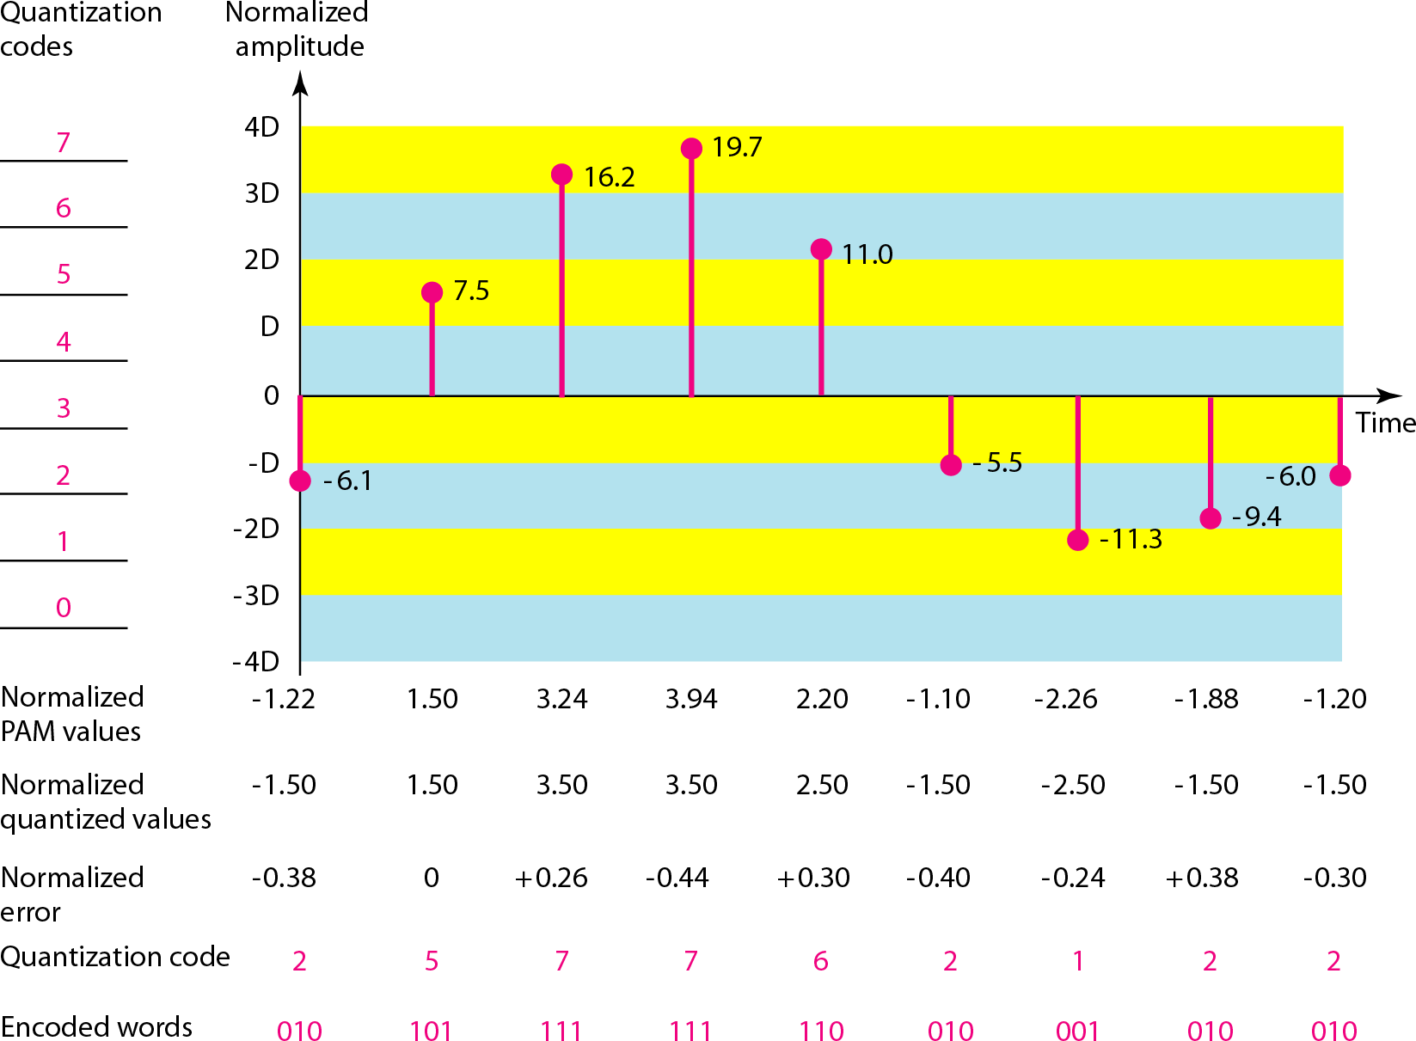
Figure 4.26 Quantization and encoding of a sampled signal

Slide 13
Quantization Error
When a signal is quantized, we introduce an error - the coded signal is an approximation of the actual amplitude value.
The difference between actual and coded value (midpoint) is referred to as the quantization error.
The more zones, the smaller Δ which results in smaller errors.
BUT, the more zones the more bits required to encode the samples -> higher bit rate

Slide 14
Quantization Error and SN_{Q}R
Signals with lower amplitude values will suffer more from quantization error as the error range: Δ/2, is fixed for all signal levels.
Non linear quantization is used to alleviate this problem. Goal is to keep SN_{Q}R fixed for all sample values.
Two approaches:
The quantization levels follow a logarithmic curve. Smaller Δ’s at lower amplitudes and larger Δ’s at higher amplitudes.
Companding: The sample values are compressed at the sender into logarithmic zones, and then expanded at the receiver. The zones are fixed in height.

Slide 15
Bit rate and bandwidth requirements of PCM
The bit rate of a PCM signal can be calculated form
the number of bits per sample x the sampling rate
Bit rate = n_{b} x f_{s}
The bandwidth required to transmit this signal depends on the type of line encoding used. Refer to previous section for discussion and formulas.
A digitized signal will always need more bandwidth than the original analog signal. Price we pay for robustness and other features of digital transmission.

